Slide 1
Driver communication between C5509A and Penta Linux on ZynQ

Slide 2
Agendal
C5509A
ZynQ 7000 - SoC
McBSP and SPI
Solutions

Slide 3
C5509A
Features
Up to 3 Multichannel Buffered Serial Ports (McBSPs)
Six-Channel Direct Memory Access (DMA) Controller
4-Channel (BGA) or 2-Channel (LQFP) 10-Bit Successive Approximation A/D

Slide 4
ZynQ 7000 - SoC
Core A9 & FPGA - Linux & RTOS
Features
Two full-duplex SPI ports with three peripheral chip selects
8-Channel DMA Controller
Memory-to-memory
memory-to-peripheral
peripheral-to-memory
scatter-gather transaction support
Two 12-Bit Analog-to-Digital Converters
On-chip voltage and temperature sensing
Up to 17 external differential input channels
One million samples per second maximum conversion rate
DSP Blocks
18 x 25 signed multiply
48-bit adder/accumulator
25-bit pre-adder
Peripgerals
2x UART, 2x CAN 2.0B, 2x I2C, 2x SPI, 4x 32b GPIO

Slide 5
McBSP
Mulitichannel Buffered Serial Port
Standard protocol
The primary use for the McBSP is for audio interface purposes
The McBSP consists of a data path and a control path that connect to external devices.
Separate pins for transmission and reception communicate data to these external devices.
Direct interface to: SPI devices

Slide 6
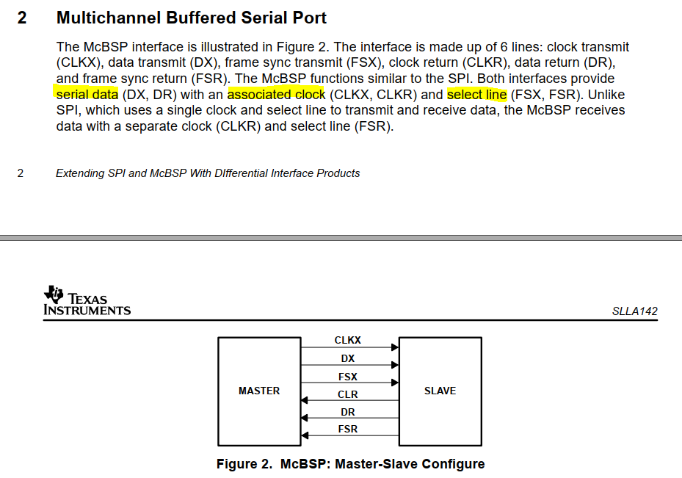
McBSP
6 lines
clock transmit - CLKX
clock receive- CLKR
frame sync transmit - FSX
frame sync receive - FSR
Data transmit - DX
Data receive - DR

Slide 7
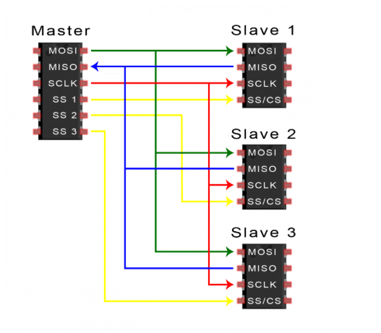
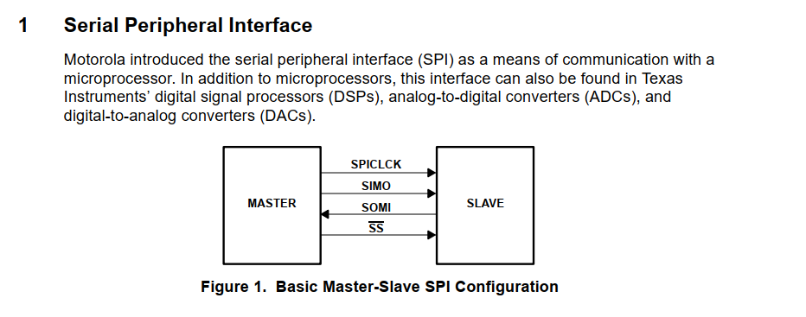
SPI
- 4 Lines

Slide 8
Connection - McBSP as SPI Slave
DX --> MOSI
DR <-- MISO
CLKR <-- SCK
FSR <-- CS

Slide 9
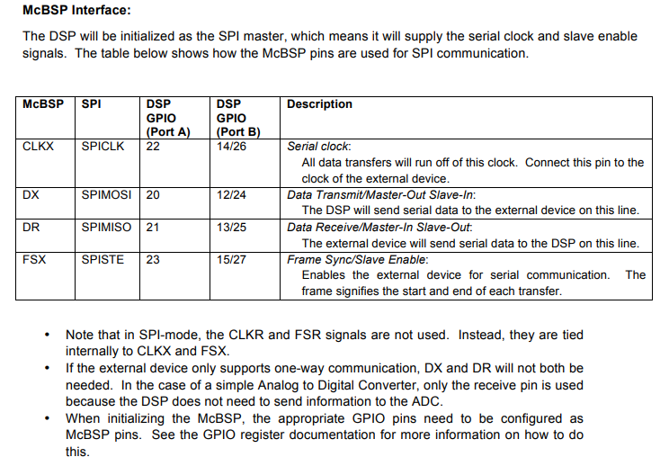
Connection - McBSP as SPI Master
DX --> MOSI
DR <-- MISO
CLKX --> SCK
FSX --> CS

Slide 10
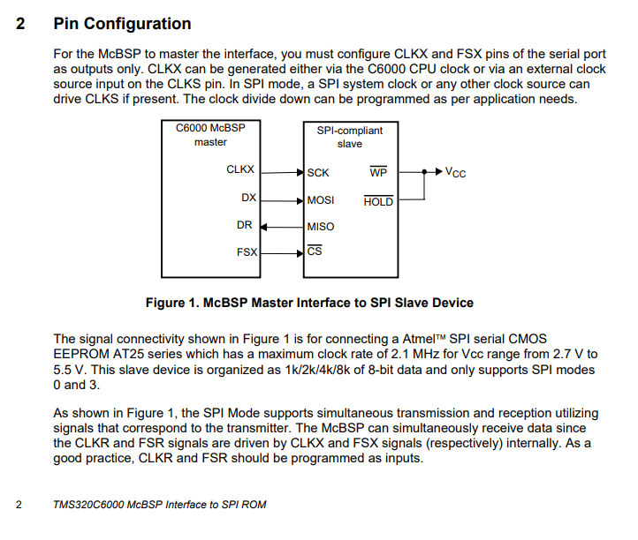
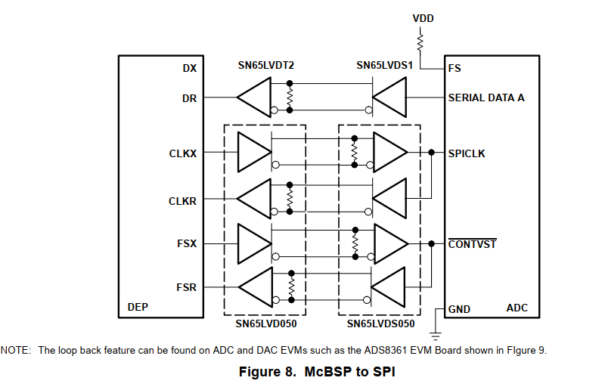
Connection - McBSP as Master

Slide 11
Solutions
Communication between C5509A and ZynQ by SPI protocol.
Target:
SPI driver on Linux kernel run in ZynQ.

